Slide 1
Graph Theory
Members:
Onais Ali Shah 21K-4691
Zohaib Saqib 21K-3215
Teacher: Sir Usama Antuley

Slide 2
Contents
01 Simple and Complete Graph
02 Bipartite and Tripartite Graph
03 Havel-Hakimi Algorithm
04 Depth-First Search Algorithm
05 Breadth-First Search Algorithm
06 Max-Flow Algorithm
07 Real Life Applications
08 References

Slide 3
Language
Libraries
Python
Networkx For graph operations
Matplotlib For graph plotting

Slide 4
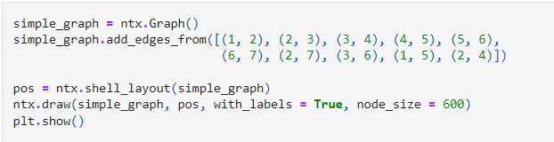
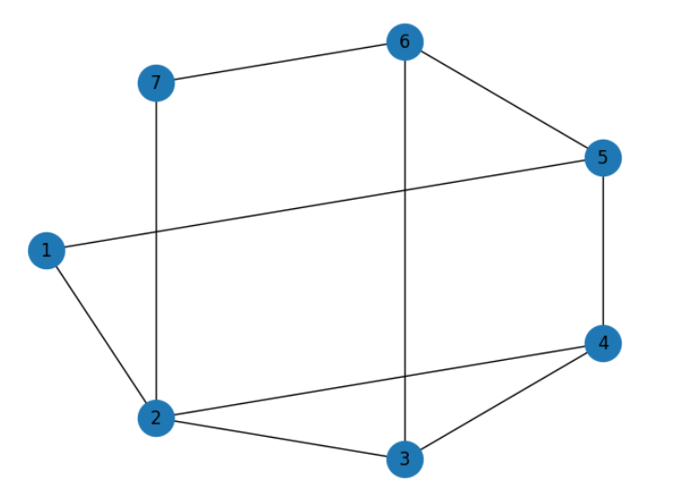
Simple Graph
A simple graph is a graph that does not have more than one edge between any two vertices and no edge starts and ends at the same vertex. In other words a simple graph is a graph without loops and multiple edges.

Slide 5
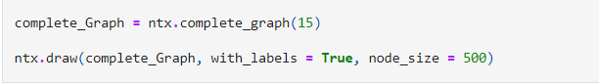
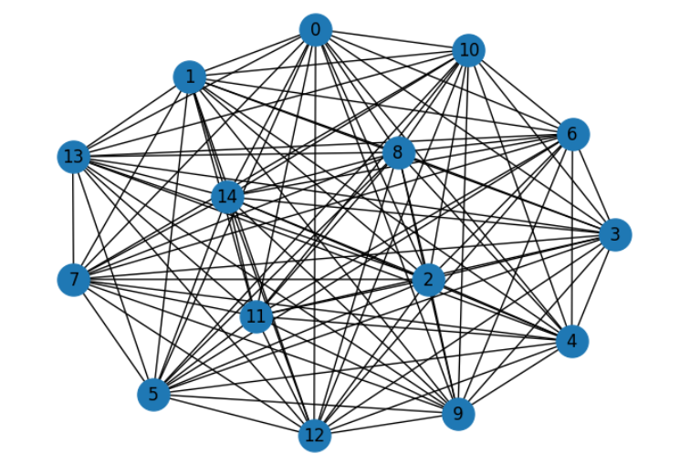
Complete Graph
A complete graph is a graph in which there is a unique edge between every pair of distinct nodes. In other words, every node is directly connected to every other node in the graph.

Slide 6
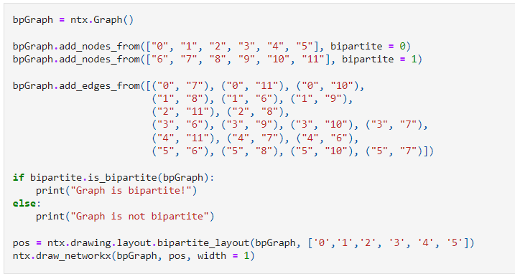
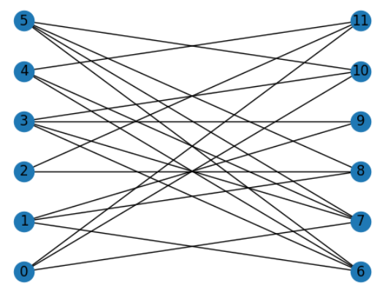
Bipartite Graph
A bipartite graph is a graph where the vertices can be divided into two disjoint sets such that all edges connect a vertex in one set to a vertex in another set.

Slide 7
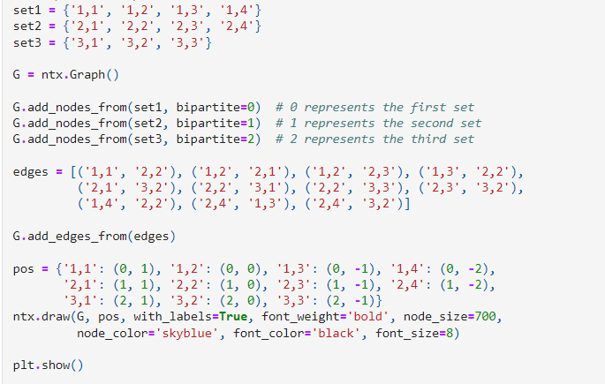
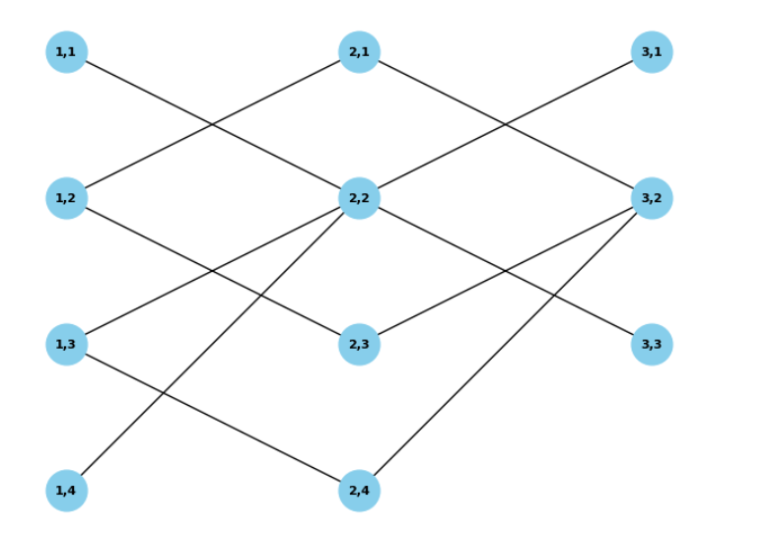
Tripartite Graph
A set of graph vertices decomposed into three disjoint sets such that no two graph vertices within the same set are adjacent and such that every vertex of each set graph vertices is adjacent to every vertex in the other two sets

Slide 8
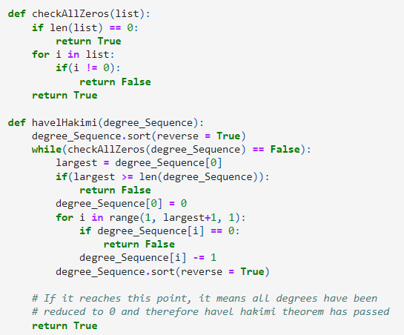
Havel-Hakimi Algorithm
The Havel-Hakimi algorithm constructs a special solution if a simple graph for the given degree sequence exists, or proves that one cannot find a positive answer.

Slide 9
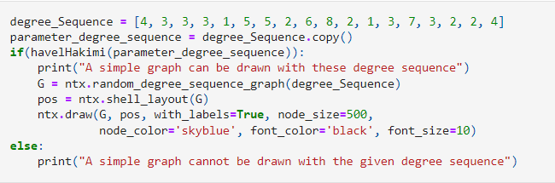
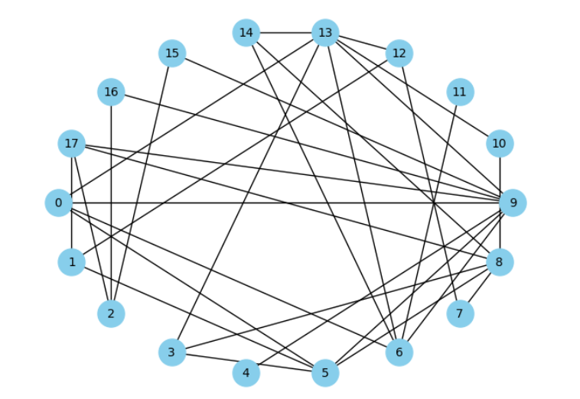
Havel-Hakimi Algorithm
continued…

Slide 10
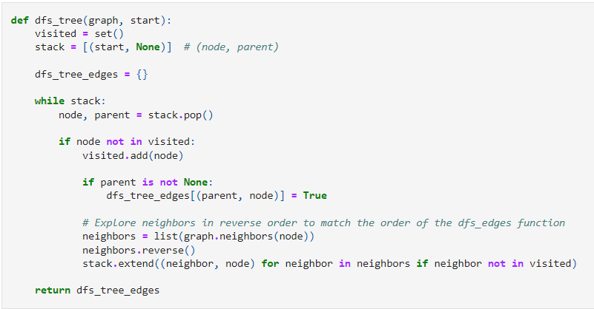
Depth-First Search
Depth-first Search is an algorithm for searching all the vertices of a graph or tree data structure.

Slide 11
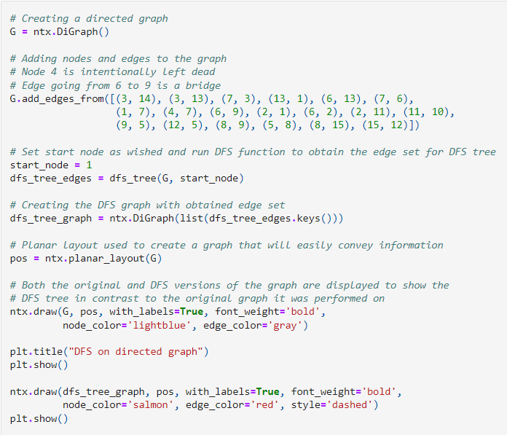
Depth-First Search
For Directed graphs

Slide 12
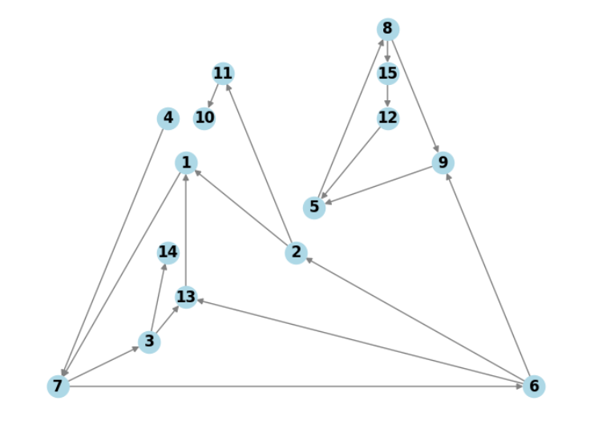
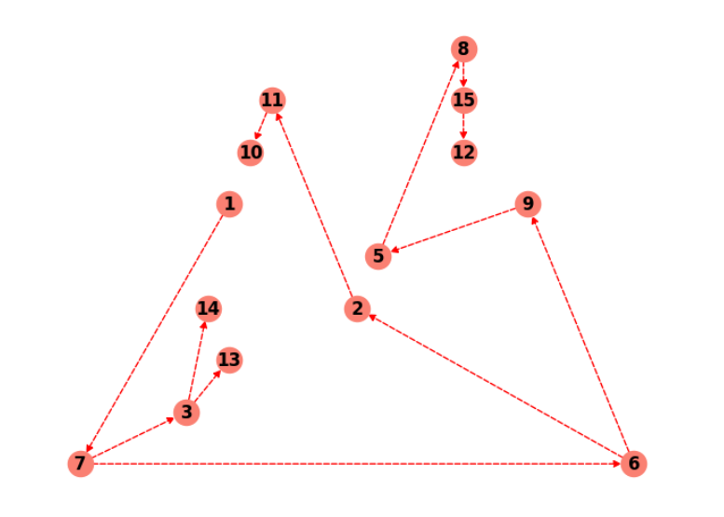
Depth-First Search
continued…

Slide 13
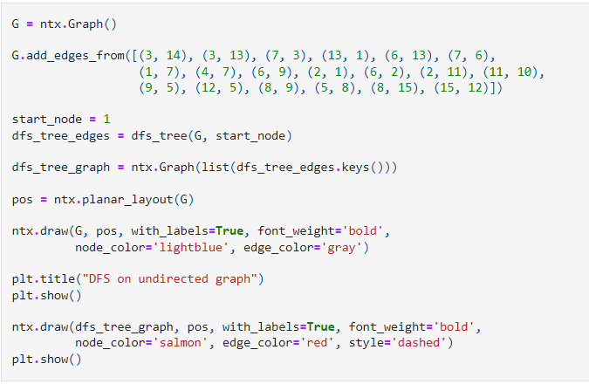
Depth-First Search
For undirected graphs

Slide 14
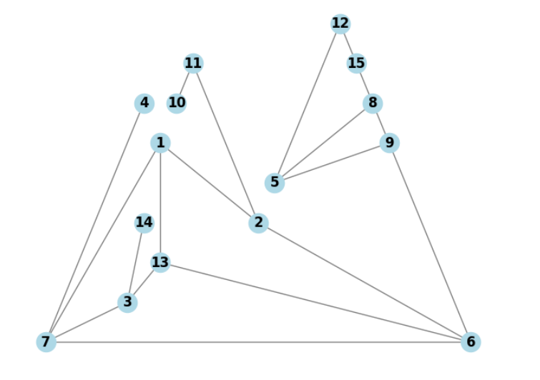
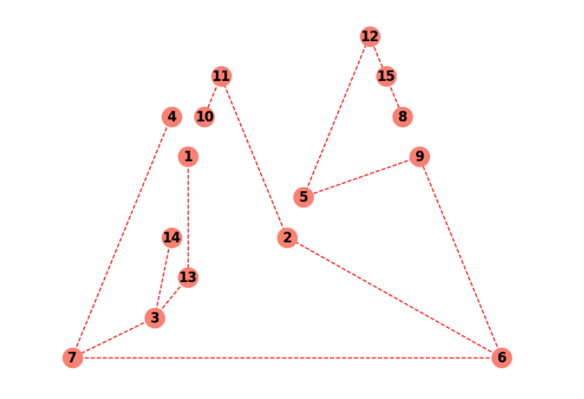
Depth-First Search
continued…

Slide 15
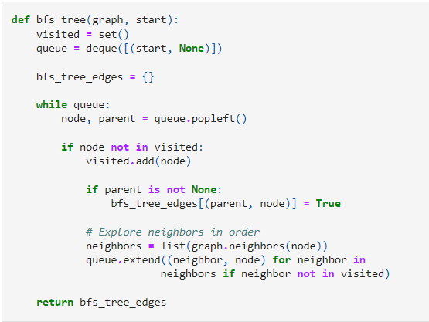
Breadth-First Search
Breadth-first Search is another algorithm for searching all the vertices of a graph or tree data structure.

Slide 16
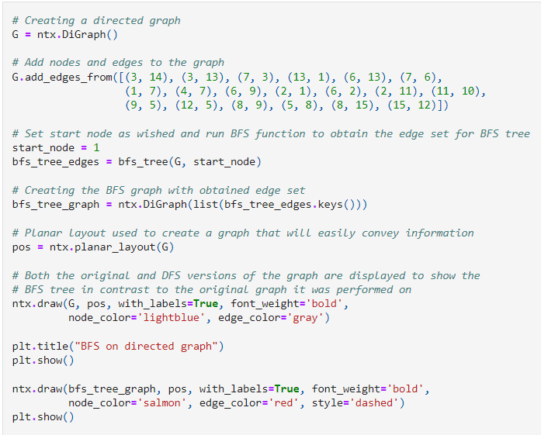
Breadth-First Search
For directed graphs

Slide 17
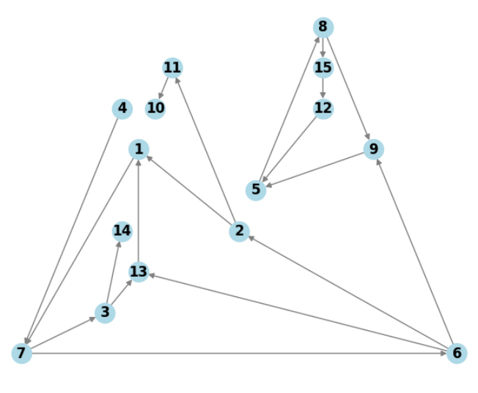
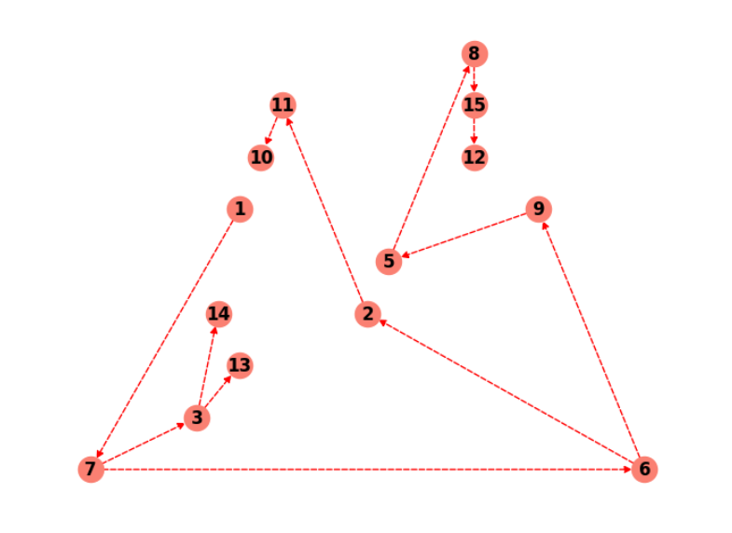
Breadth-First Search
continued…

Slide 18
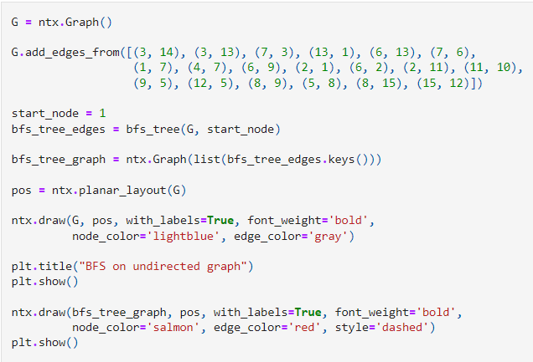
Breadth-First Search
For undirected graphs

Slide 19
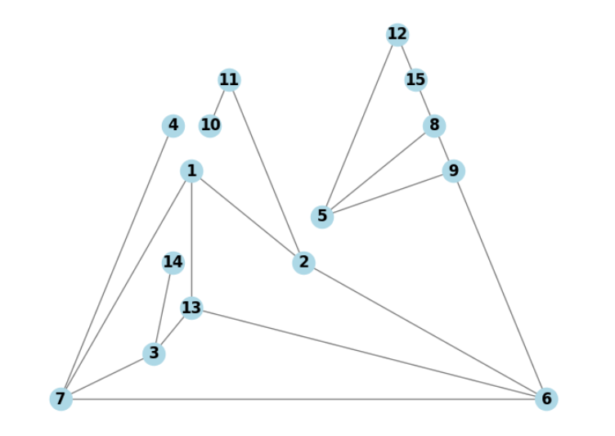
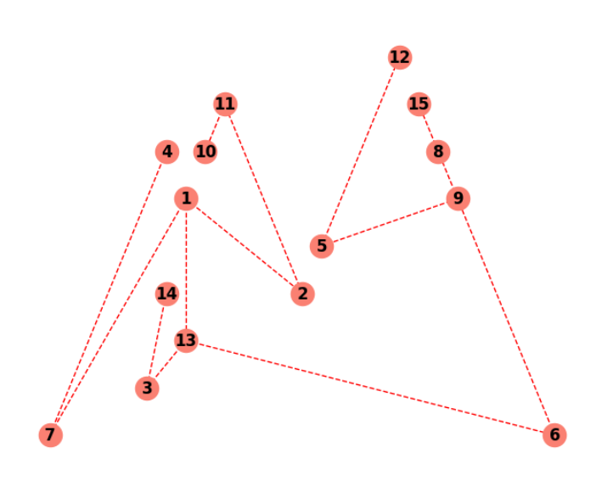
Breadth-First Search
continued…

Slide 20
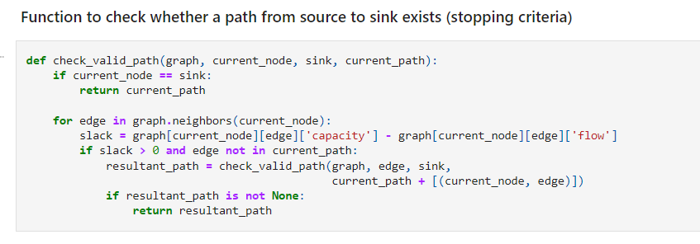
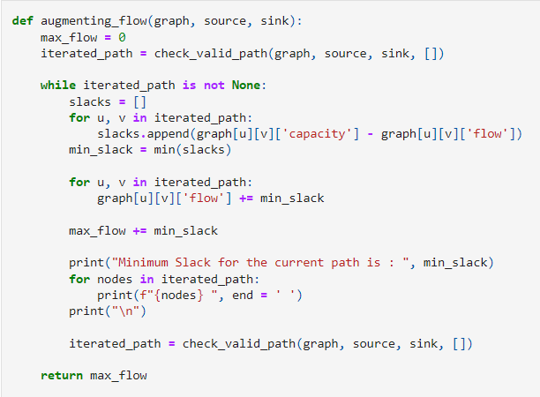
Max Flow Algorithm
The Max Flow or Ford-Fulkerson algorithm is an algorithm that tackles the max-flow min-cut problem. That is, given a network with vertices and edges between those vertices that have certain weights, how much "flow" can the network process at a time.

Slide 21
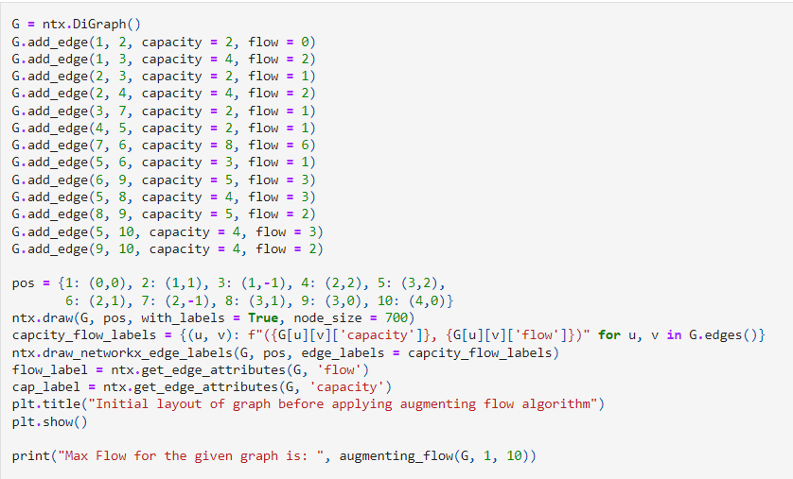
Max Flow Algorithm
Graph before applying the algorithm

Slide 22
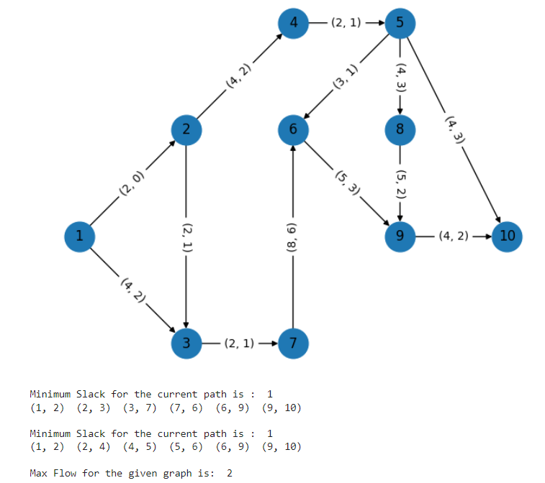
Max Flow Algorithm
Graph before applying the algorithm

Slide 23
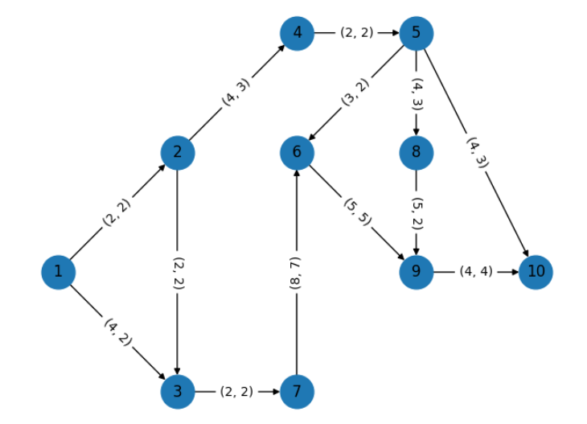
Max Flow Algorithm
Graph after applying the algorithm

Slide 24
Real Life Applications
Breadth-First Search:
Crawlers in Search Engine
GPS Navigating systems
Peer-to-Peer Networking
Depth-First Search:
Solving Problems with one solution
Model Checking
Maze Generation
Max Flow Algorithm:
Supply Chain Management
Resource Allocation
Transportation Networks

Slide 25
References
https://www.geeksforgeeks.org/applications-of-depth-first-search/
https://medium.com/edureka/breadth-first-search-algorithm-17d2c72f0eaa
https://www.sciencedirect.com/topics/computer-science/augmenting-path

Slide 26
Thank you!
If you have any questions you can ask now

